Slide 1
Testing

Slide 2
Agenda
End-to-End vs Unit Testing
Unit testing
Python unittest example
Mocking
End-to-End Testing:Selenium

Slide 3
Automated Tests
Test execution is handled by a tool rather than a human
Advantages:
Faster test execution
Higher testing coverage

Slide 4
End-to-End vs Unit Testing
E2E Testing | Unit Testing
Test the complete integrated system | Test the smallest testable part of your code e.g: function,class
Written by testers | Written by developers
Takes the entire system into consideration | Easier to detect and fix errors

Slide 5
Unit Testing

Slide 6
Example: Python unittest

Slide 7
Automated Unit Tests
Script to check unit behaves as expected
Pass diﬀerent inputs to the unit and assert that the output is similar to the expectation

Slide 8
Example
Function behaves as follows:
Return True if the two strings start with the same letter
Return False if the two strings start with diﬀerent letters
Raise a TypeError if one of the strings is None

Slide 9
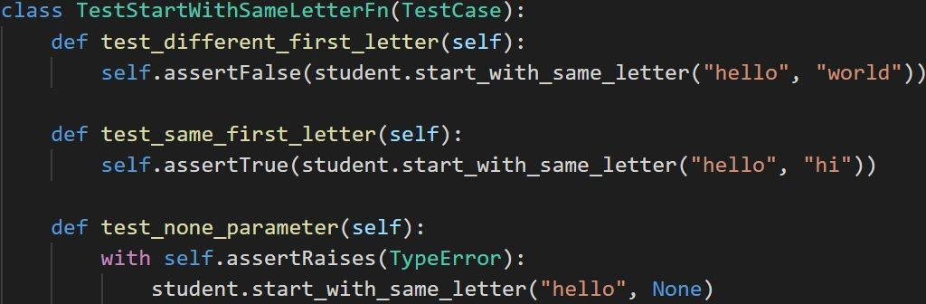
Example

Slide 10
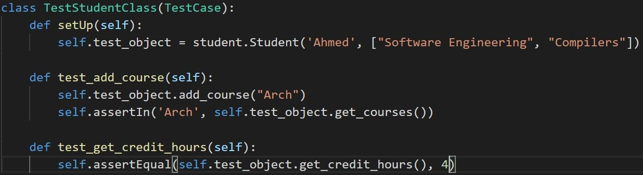
Example
Unit test should not depend on each other
Set up test variables before executing each test function

Slide 11
Mocking

Slide 12
Mocking
Unit depends on a service provided by module that is not yet implemented
Test the unit by creating an object that mocks the interface and behaviour of the missing service
Mock object returns fake(hard coded) data that have the same format as the original

Slide 13
Example
Refer to the example in the “Mocking” folder

Slide 14
End-to-End Testing: Selenium

Slide 15
Selenium
Web testing automation framework
Provides playback tool(Selenium IDE) and browser automation driver(Selenium WebDriver)
Supports many languages and many browsers

Slide 16
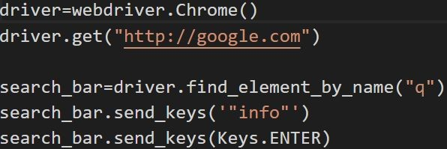
Selenium:Example
Webdriver contains classes that control diﬀerent browsers
get : directs the browser to url
We can interact with any element in the page by searching for the element using its name,tag,id and other attributes
Element interaction includes entering text,clicking on the element,..

Slide 17
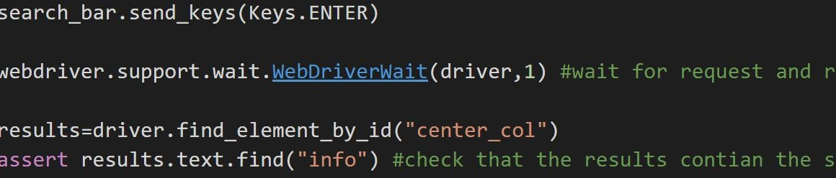
Selenium:Example
If an action will cause a page or dynamic content to load we can wait a few seconds using WebDriverWait to ensure that the content is loaded

Slide 18
Thank You

